Slide 1
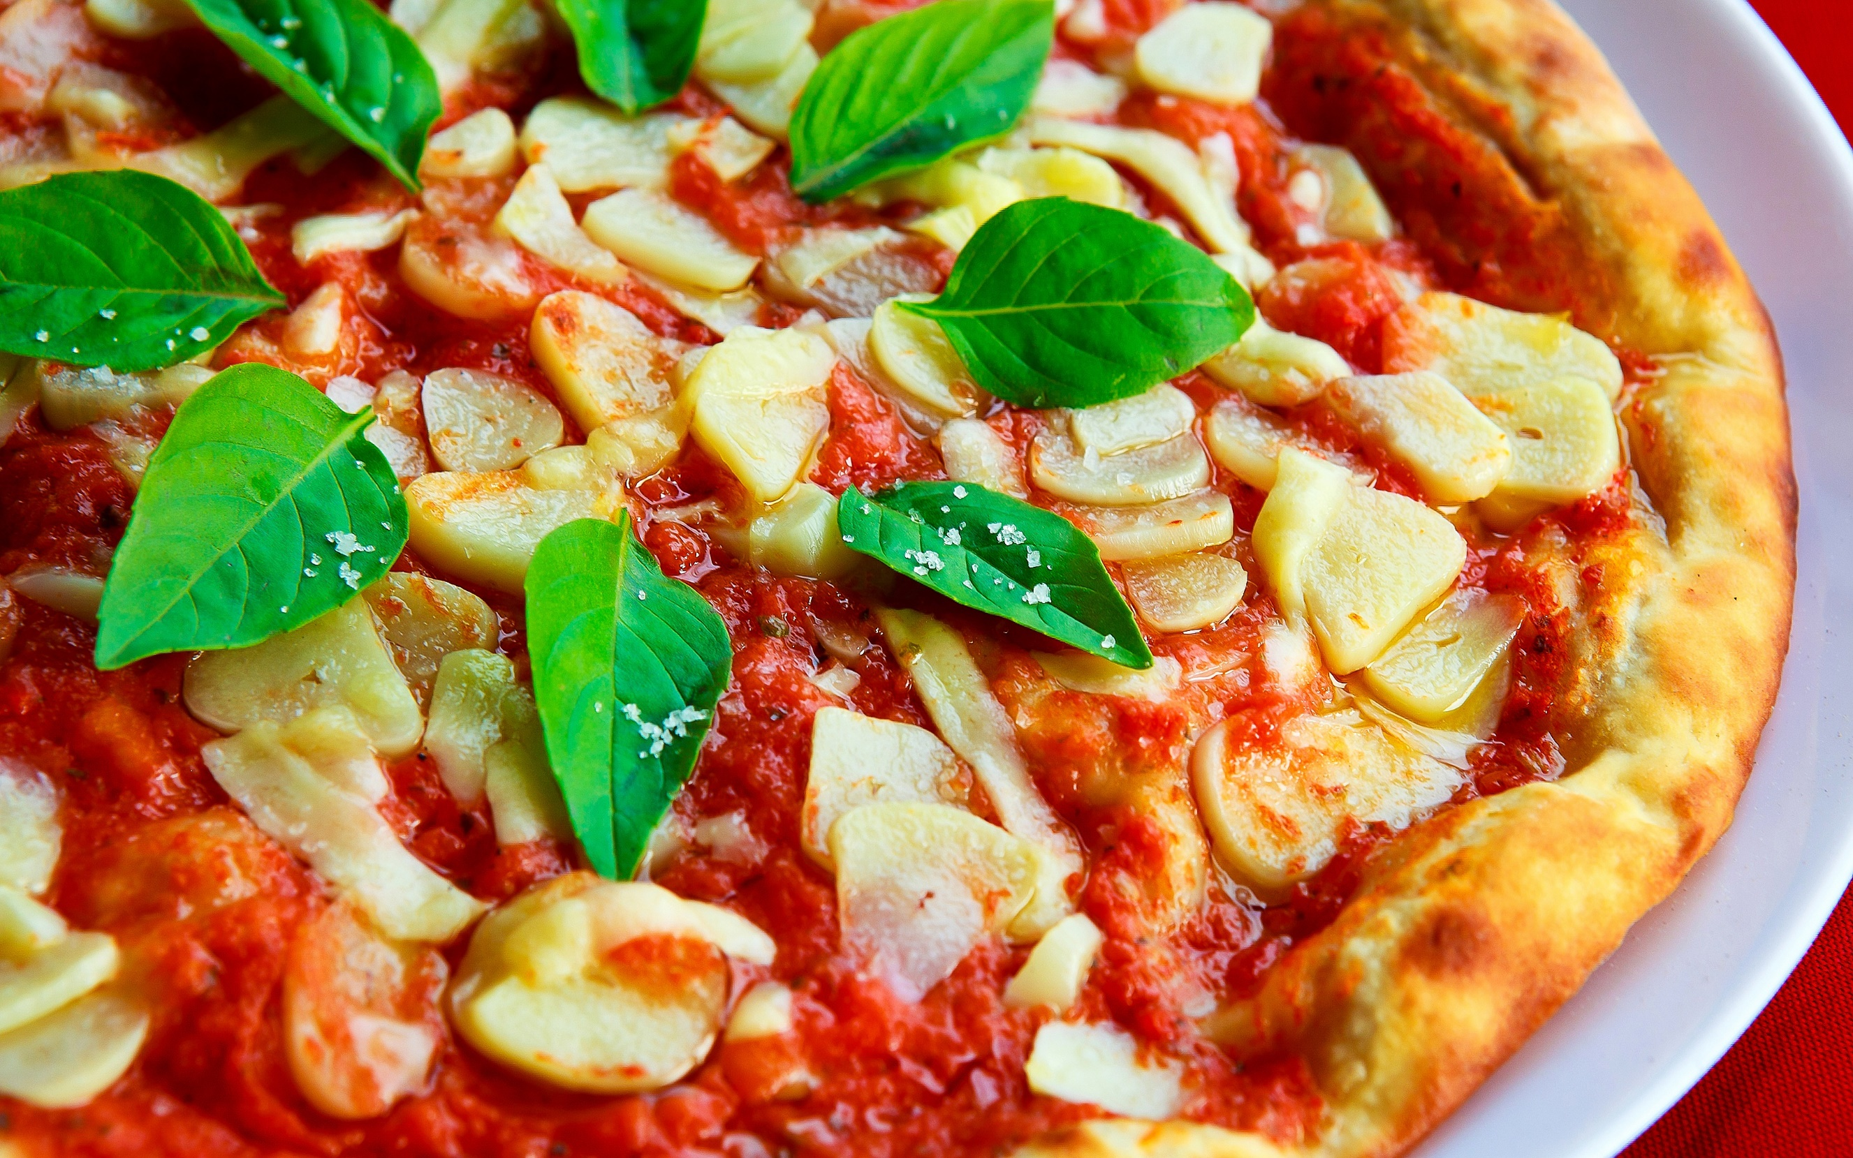
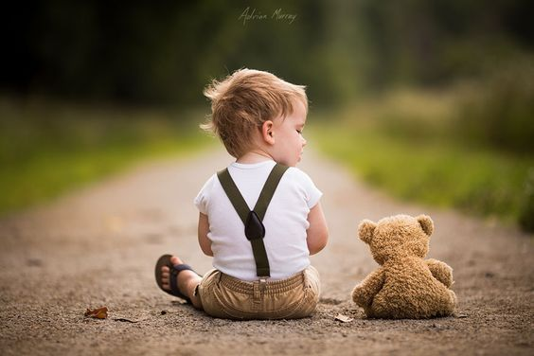
E-TALKING BEST FOR YOU
E-TALKING BEST FOR YOU
Food
Let’s talk about what you eat!
view

Slide 2
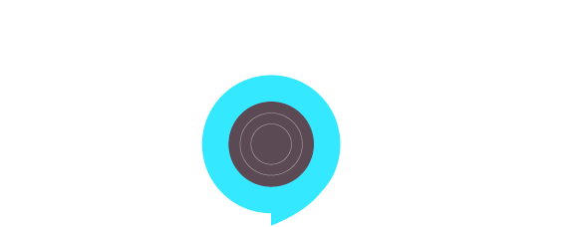
E-TALKING BEST FOR YOU
E-TALKING BEST FOR YOU
INTRODUCTION
CEF Learning Goal: Getting more familiar with adverbs of frequency

Slide 3
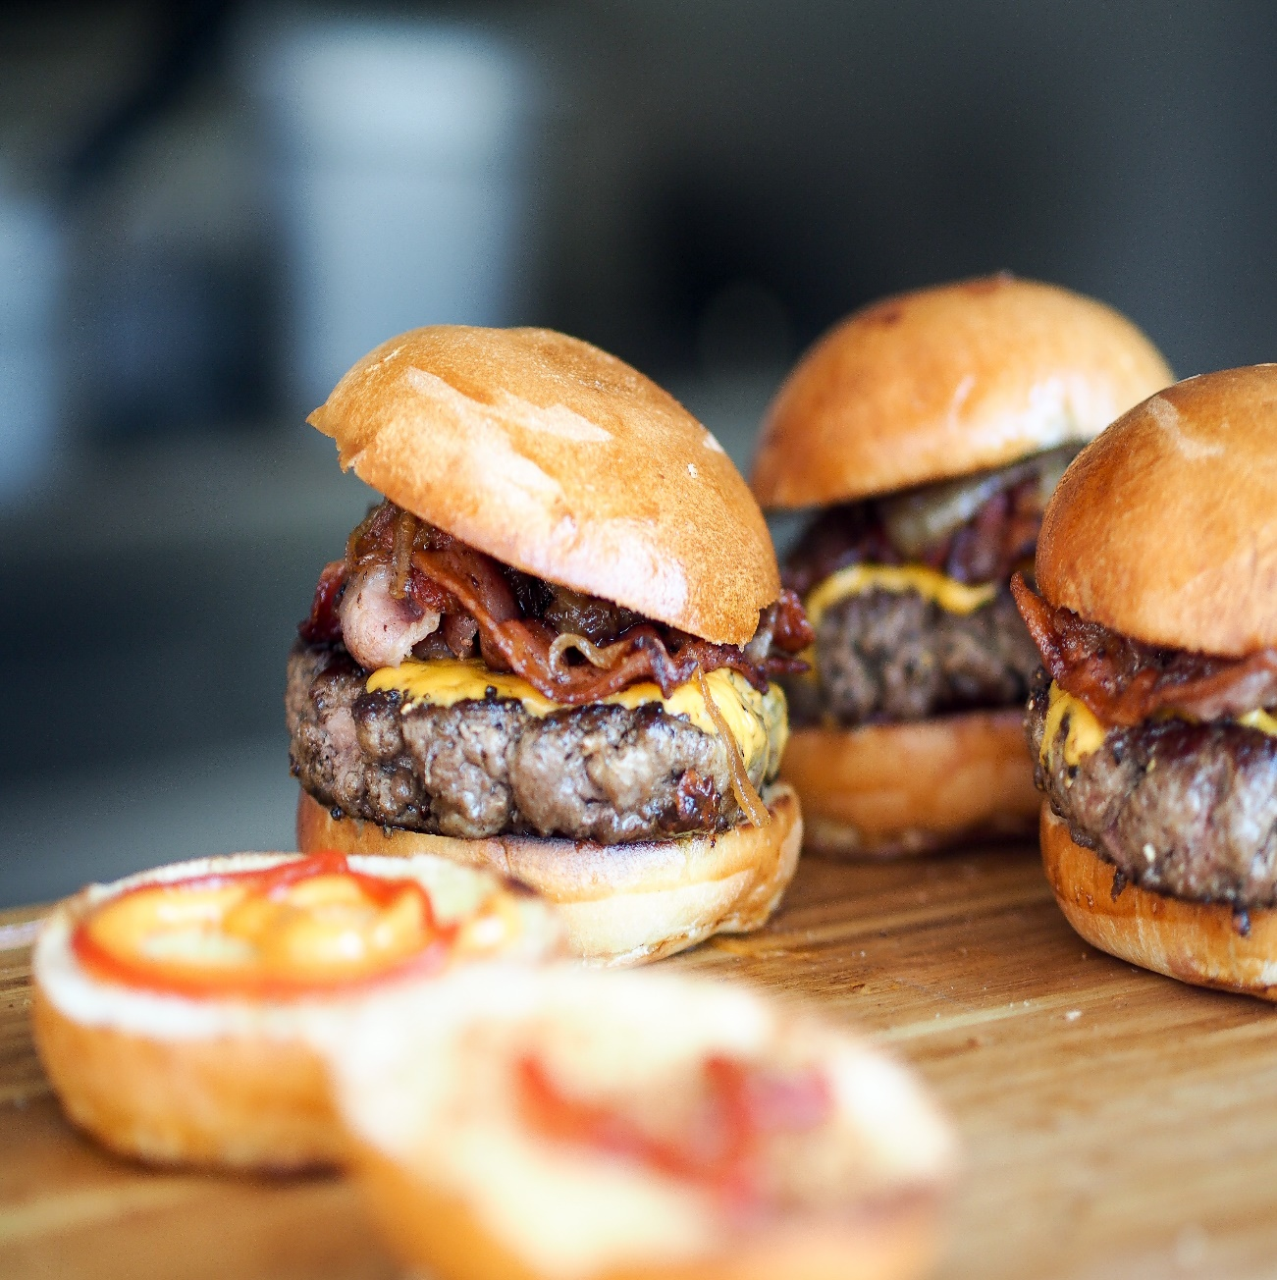
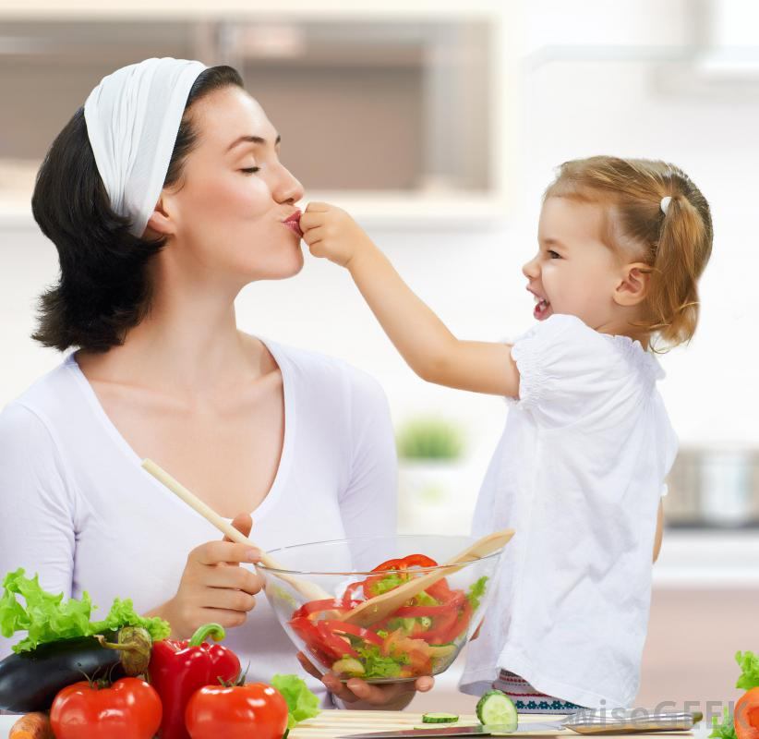
E-TALKING BEST FOR YOU
E-TALKING BEST FOR YOU
We eat food every day. Delicious food makes our day, but terrible food can ruin them. In this lesson, we will talk about different kinds of food.
START
Image from : unsplash.com

Slide 4

E-TALKING BEST FOR YOU
E-TALKING BEST FOR YOU
WARM-UP
What do you like to eat in the morning?
What do you usually eat for lunch?

Slide 5

E-TALKING BEST FOR YOU
E-TALKING BEST FOR YOU
E-TALKING BEST FOR YOU
GETTING STARTED
Do you drink coffee in the morning?
Are you a vegetarian?

Slide 6
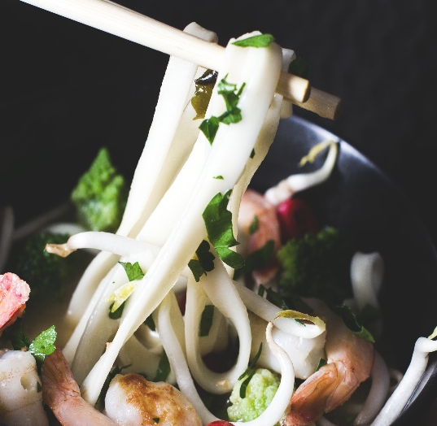
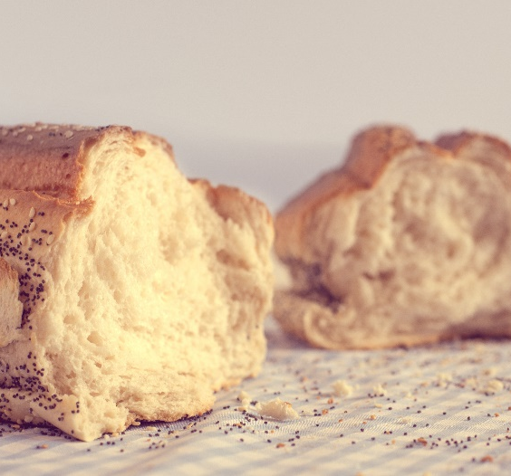
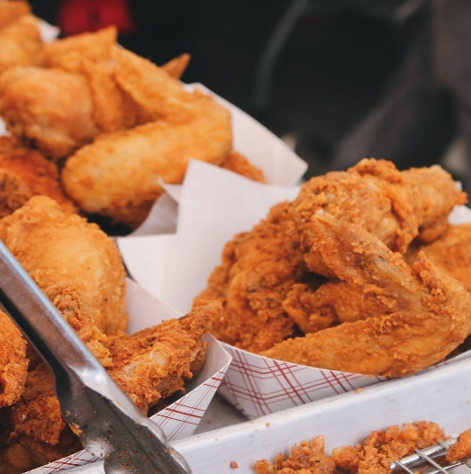
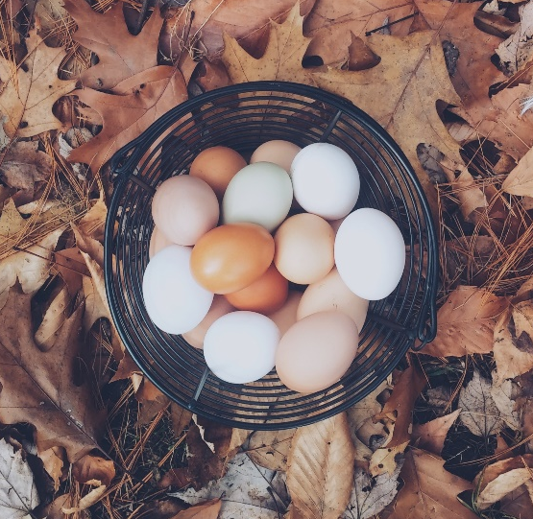
E-TALKING BEST FOR YOU
01 Food
E-TALKING BEST FOR YOU
Here are some food that you might eat in your daily meals:
I like to eat fruits for breakfast.
Joshua likes juice.
Noodles
Rice
Bread
Vegetables
Chicken
Fish
Fruit
Eggs
Image from : unsplash.com
Image from : unsplash.com
Image from : unsplash.com
Image from : unsplash.com

Slide 7
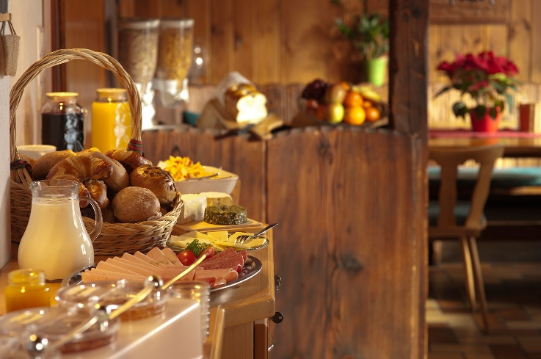
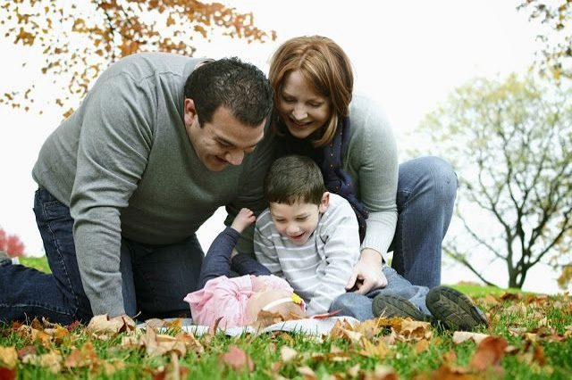

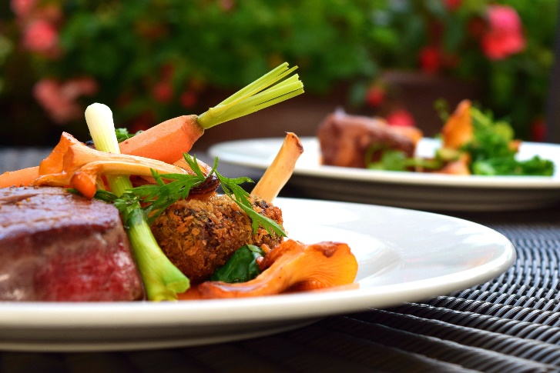
E-TALKING BEST FOR YOU
01 Food
Practice
What do you like to eat for breakfast?
What about for lunch and dinner?
Image from: unsplash.com

Slide 8
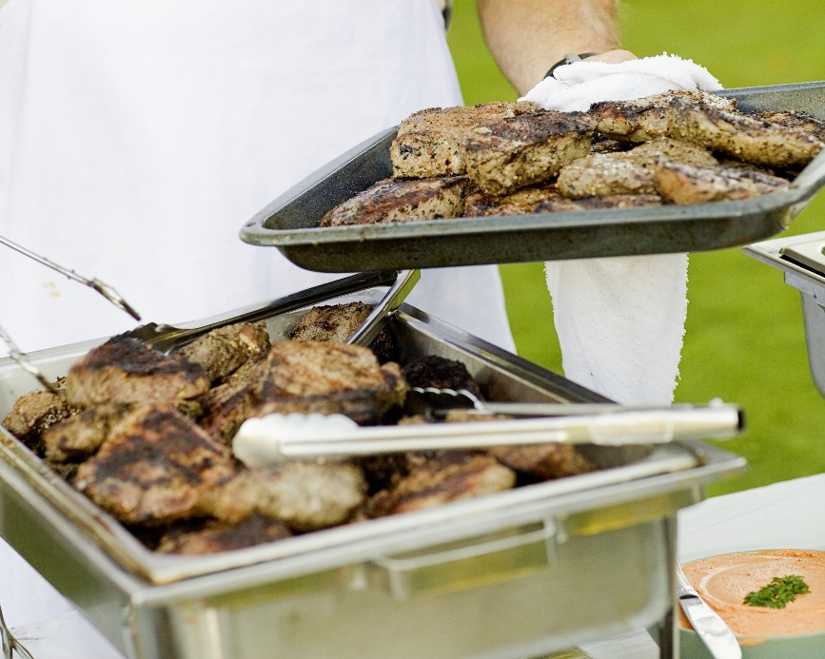
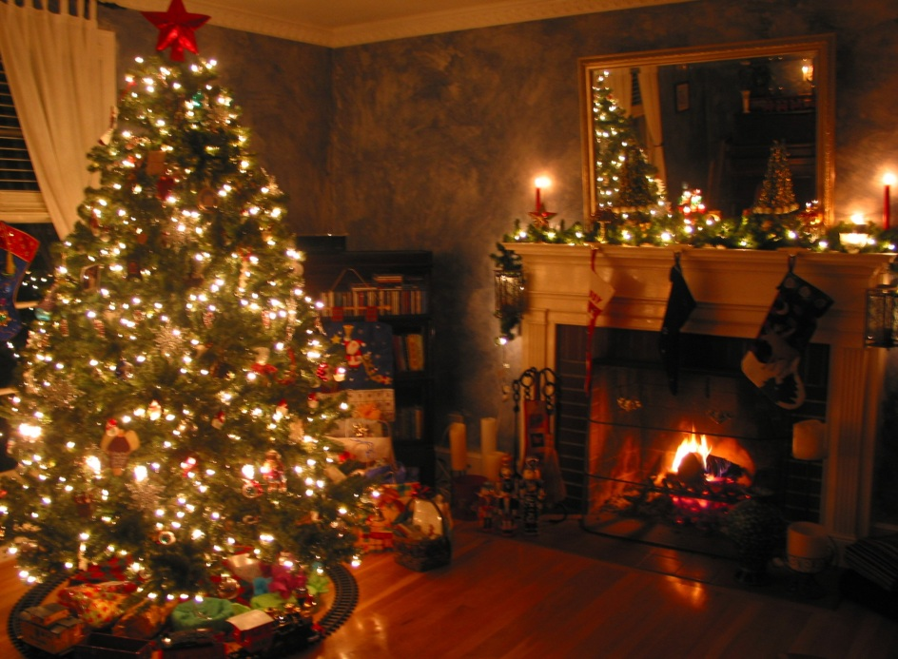

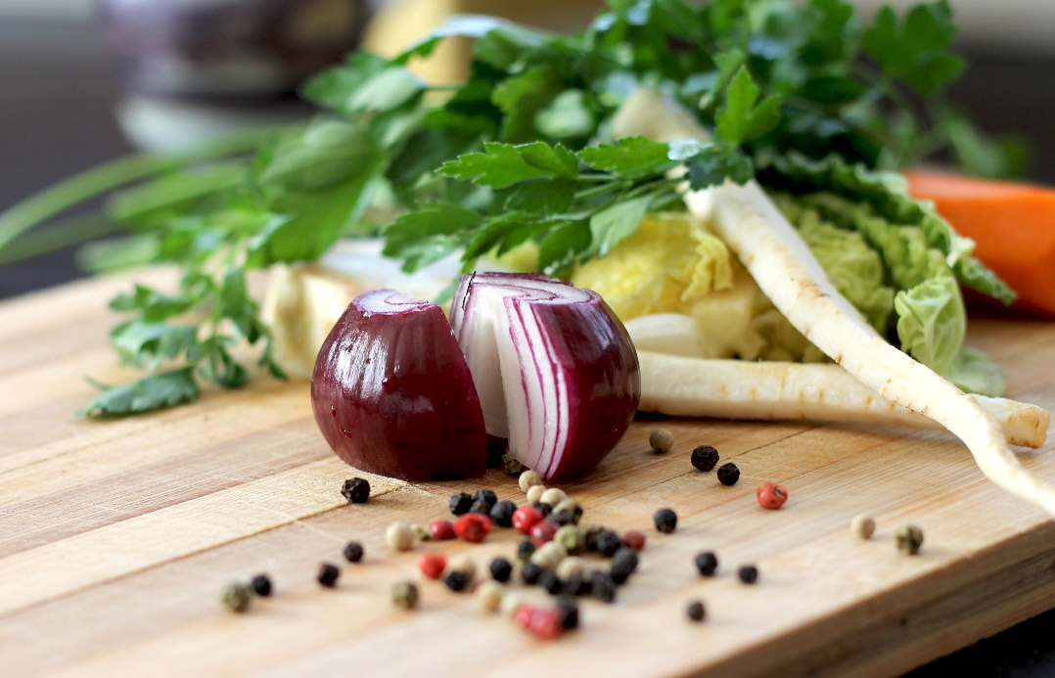
E-TALKING BEST FOR YOU
02 Reading: players vs. models
E-TALKING BEST FOR YOU
Different kinds of people eat different kinds of food. Basketball players need lots of calories every day, so they eat big breakfasts every morning. They usually eat steaks, pizza, and pasta for dinner after a day’s training. As for models, they cannot eat too much. They usually eat fruits and salads every day for breakfast and lunch.
Image from : unsplash.com
Image from : unsplash.com

Slide 9
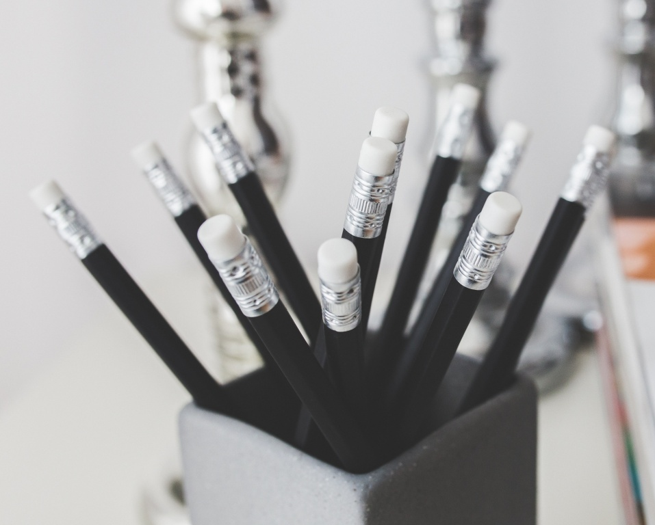
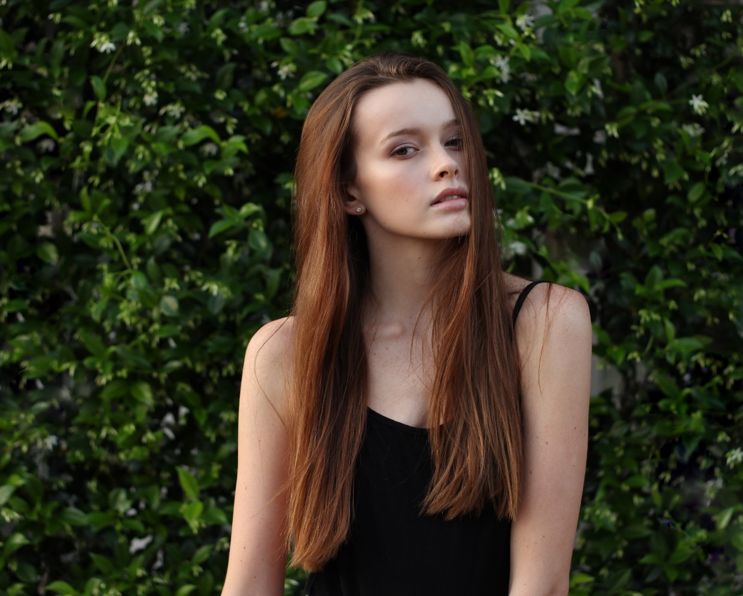
E-TALKING BEST FOR YOU
02 Reading: players vs. models
E-TALKING BEST FOR YOU
Practice:
What kind of people eat a lot of food each day?
According to the text, what do supermodels eat for breakfast? Is it true?
Image from : http://www.sfgate.com/education/article/Cuts-in-programs-to-help-inmates-questioned-3199585.php#photo-2338768

Slide 10

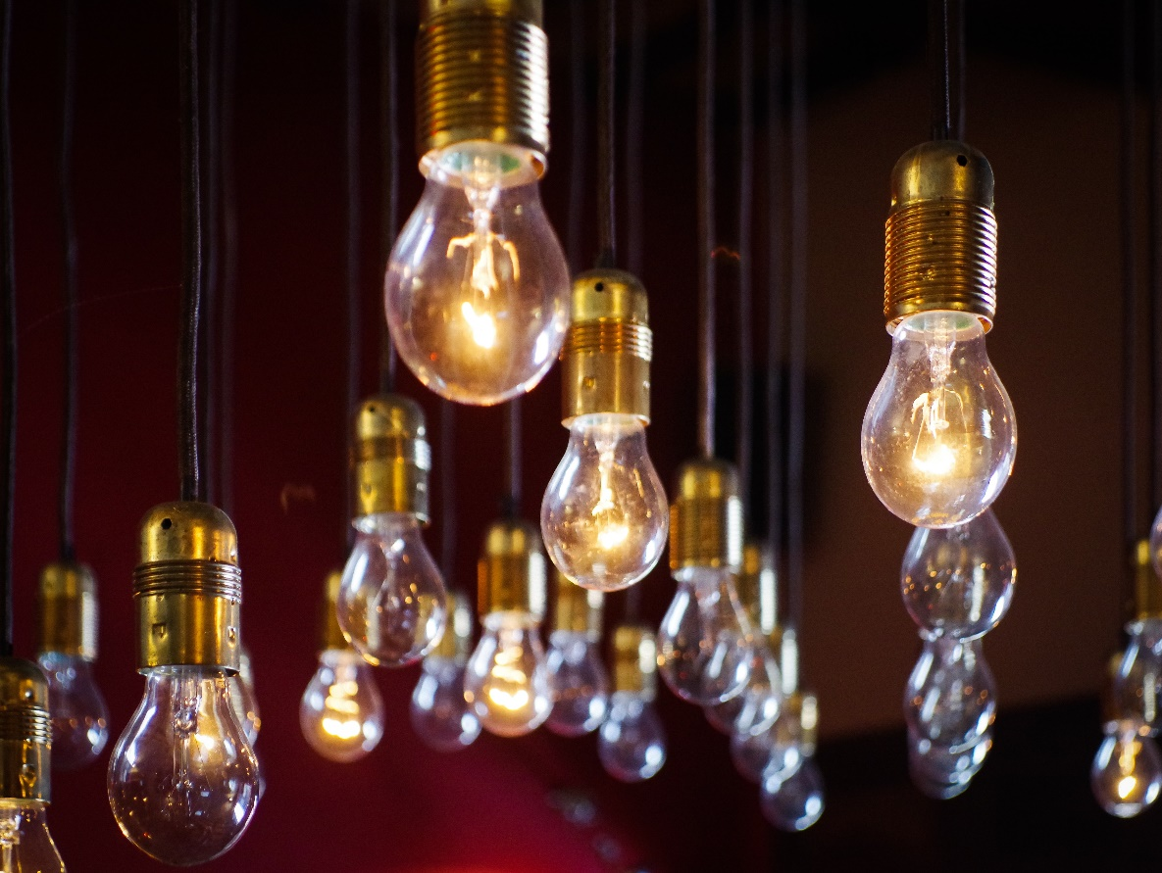
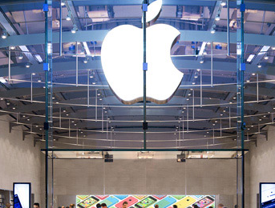

E-TALKING BEST FOR YOU
03 Adverbs of frequency
E-TALKING BEST FOR YOU
0%-----------------------------------------------------→100%
Never→ sometimes→ often→ usually→ always
Image from : unsplash.com
Image from : unsplash.com

Slide 11
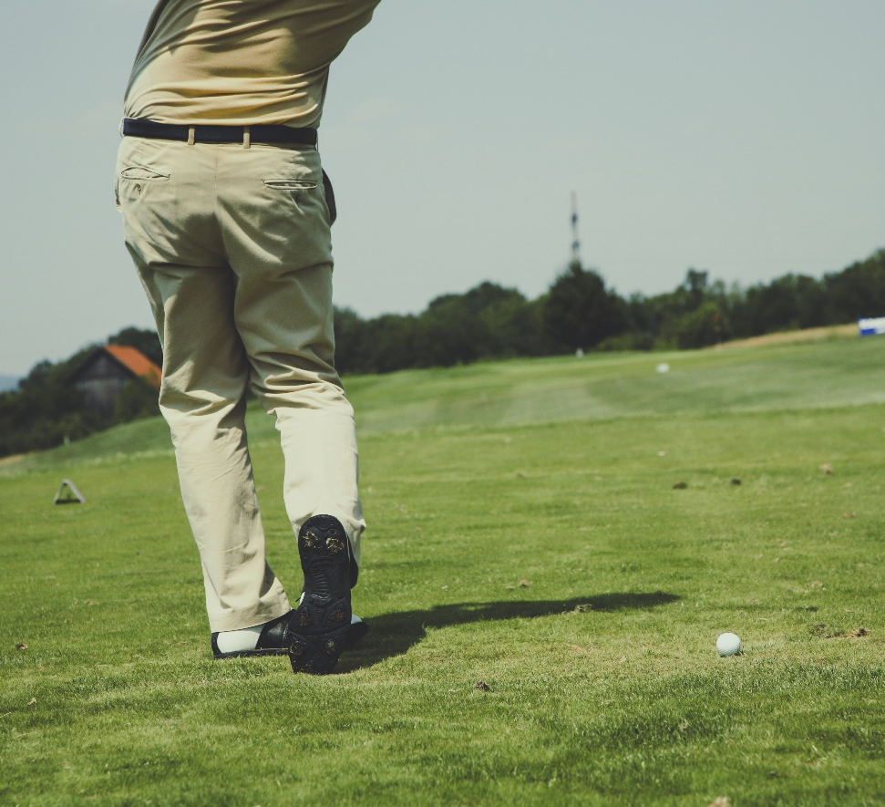
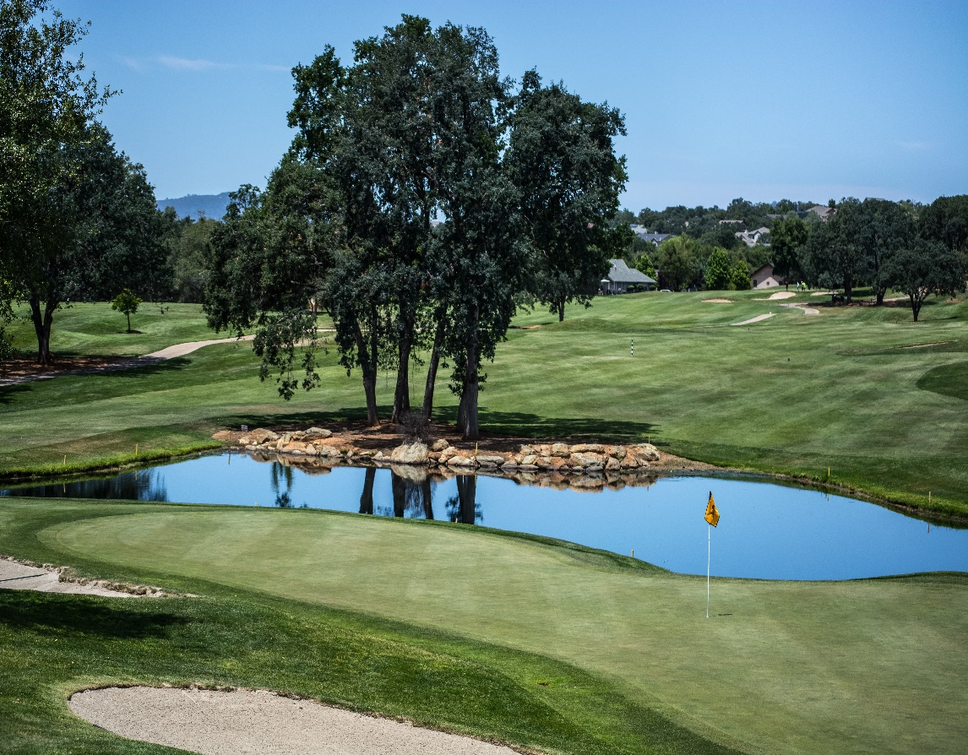
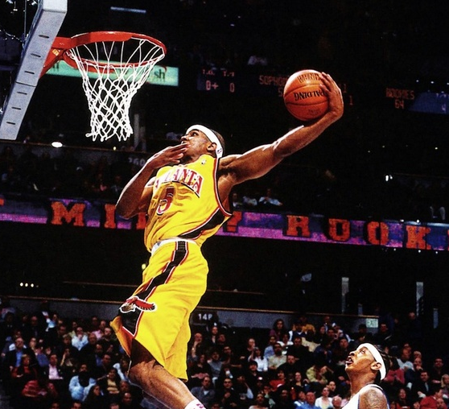
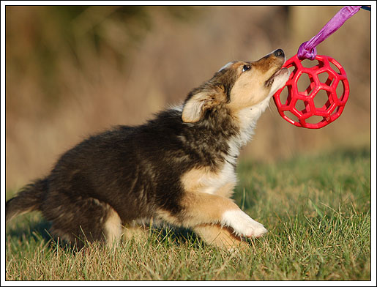
E-TALKING BEST FOR YOU
03 Adverbs of frequency
E-TALKING BEST FOR YOU
Do you play golf?
Yes, I always / usually / often / sometimes play golf.
No, I don’t often / never play golf.
Image from unsplash.com
Image from : unsplash.com

Slide 12
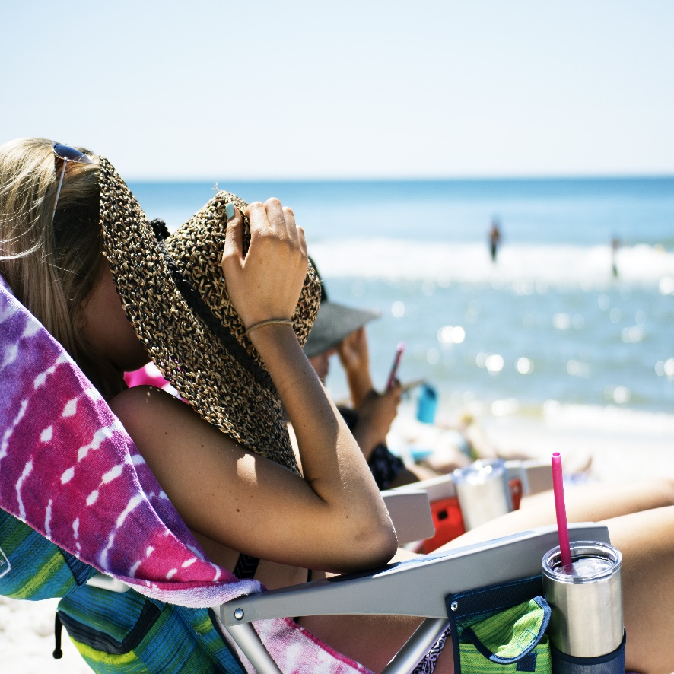

E-TALKING BEST FOR YOU
E-TALKING BEST FOR YOU
03 Adverbs of frequency
Share a special thing you do and how often you do it.
Image from : unsplash.com

Slide 13
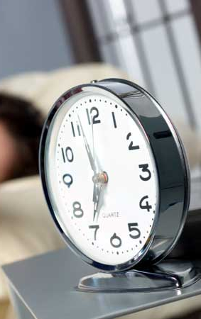

E-TALKING BEST FOR YOU
E-TALKING BEST FOR YOU
04 Linkers to sequence
I usually get up at six o’clock in the morning. First, I make a big cup of coffee, then I read the newspaper. I like to have cereal and milk but I sometimes have an egg and juice. After that, I often check my emails. Finally, at eight, I go to work. I always walk to work because it's not far from my home.
*In the article, first, then, after that, finally are
linkers to sequence.
Image from : unsplash.com

Slide 14

E-TALKING BEST FOR YOU
04 Linkers to sequence
E-TALKING BEST FOR YOU
Practice:
Talk about your morning routine using linkers to sequence.
Image from : http://www.sfgate.com/education/article/Cuts-in-programs-to-help-inmates-questioned-3199585.php#photo-2338768

Slide 15

E-TALKING BEST FOR YOU
E-TALKING BEST FOR YOU
SPEAKING TASK
First, talk to your partner and ask him/her what he/she eats for dinner.
Then, talk to another person and tell him/her about the first person’s eating habits.

Slide 16

E-TALKING BEST FOR YOU
E-TALKING BEST FOR YOU
ASSESSMENT
Think and discuss with your friends

Slide 17

E-TALKING BEST FOR YOU
E-TALKING BEST FOR YOU
What food is healthy?
What food is unhealthy?
Do you like to eat unhealthy food?
Do you usually eat healthy food?
ASSESSMENT

Slide 18


E-TALKING BEST FOR YOU
E-TALKING BEST FOR YOU
Thank you !
See you tomorrow

